Slide 1
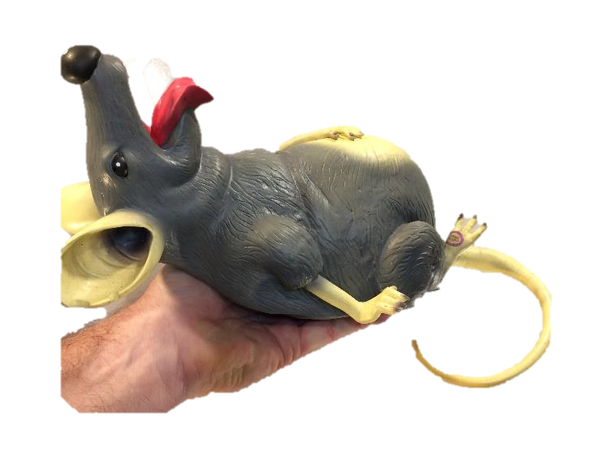
Work and Energy
Potential Energy
(The Rat Lift Problem)
LabRat Scientific
© 2018

Slide 2
Work
Work is a force that is applied over a distance. The governing equation is:
Work = Force * Displacement
Work can be positive or negative:
A force pushing/pulling in the same direction as the displacement results in positive work
A force pushing/pulling opposite the displacement results in negative work

Slide 3
Negative Work
This bean person is trying to stop the car from rolling down the hill. He must apply a force to slow it down. So a force is being applied over a distance, but the work is attempting to retard the motion. This is NEGATIVE work…

Slide 4
Energy
There are many forms of energy:
Electrical Energy
Solar Energy
Mechanical Energy
Nuclear Energy
Thermal Energy
Etc.
This lesson will focus on mechanical energy, more specifically Gravitational Potential Energy.

Slide 5
We must perform work on an object in order to change its energy state. This means that work is equal to the change in energy.
This explains why the units of Work (N*m) are the same as the units for Mechanical Energy (N*m).
In this lesson we will be dealing with gravitational potential energy:
Potential Energy = Mass * Accel Due to Gravity * Height

Slide 6
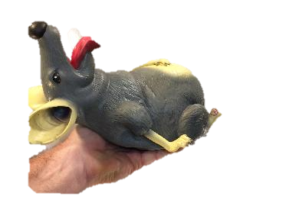
We want to lift the rat to this higher level, which increases its Potential Energy.
Height₂
∆ Height = 1.0 m
Let’s set our reference as PE=0 at this lower level. This will be Height₁.
Height₁

Slide 7
The change in Potential Energy can be easily calculated:
Change in PE = Mass * Gravity Accel * Change in Height
= 0.5 Kg * 9.8 m/sec2 * 1.0 m
= 4.9 N*m
Note: The rat has a mass of 500 g (0.5 Kg) and we lift it 1.0 m

Slide 8
Let’s look at the special case where the rat is lifted at a constant velocity (once it gets moving).
If the velocity is constant, the acceleration must be zero. For acceleration to be zero, there must be no net force acting on the object.
Since the rat has weight (downward gravity force), the upward force must be equal to the rat’s weight in order to have zero net external force.

Slide 9
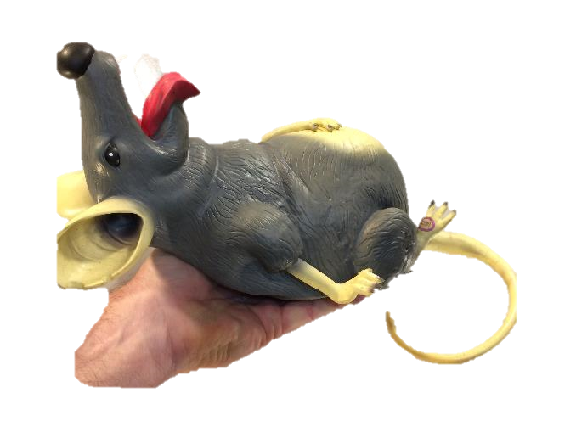
Upward force being applied by the hand
Force_{Hand} = 4.9 N
Net Force = Force_{Hand} - Weight_{Rat}
= 4.9 N - 4.9 N
= 0.0 N
Downward force being applied by gravity (a.k.a. weight)
Weight_{Rat} = 4.9 N

Slide 10
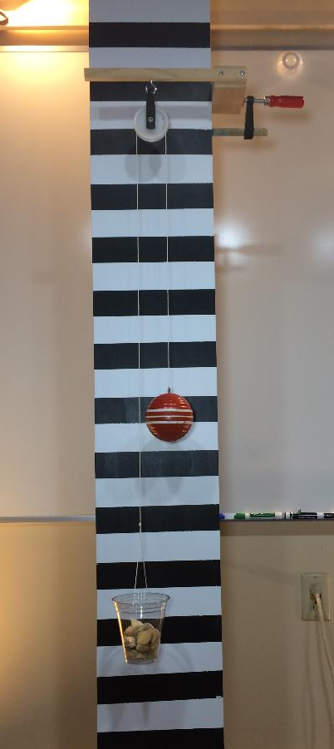
While we all generally accept Newton’s Laws of motion, it is useful (and educational) to test them out from time-to-time by conducting experiments.
In this case, we want to prove to ourselves that once we get the rat moving upwards, it will move at a constant velocity due to the existence of balanced forces.

Slide 11
Experimental Set-up
Pully
The weight cup contains rocks that have a weight that is equal to the weight of the wooden ball.
The downward force in the weight cup puts the string in tension. This tension (force) is then applied to the top of the ball.
Wooden Ball
Weight Cup

Slide 12
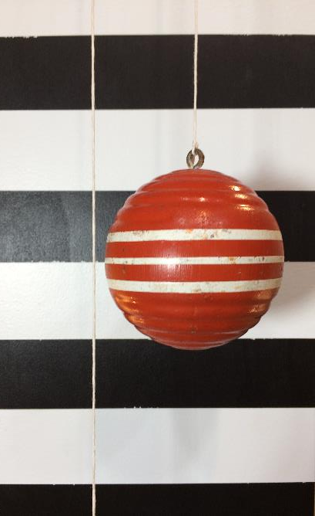
String Tension
And, of course, the ball’s weight creates a downward force.
The forces are equal and opposite, and thus the net external force acting on the ball is zero.
Newton says there will be no acceleration if there is no net external force.
F 0
F = ma a = ----- = ------- = 0.0
m m
String Tension

Slide 13
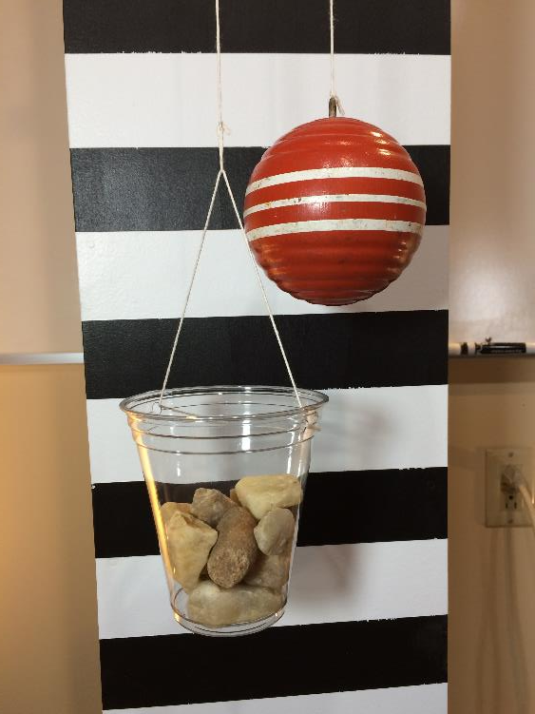
The same forces are acting on the weight cup. The ball creates a tension in the string which provides an upward force on the cup.
The system at rest shows the system in equilibrium. All the forces are equal and opposite and there is no net external force. As such, everything is static (not moving)…

Slide 14
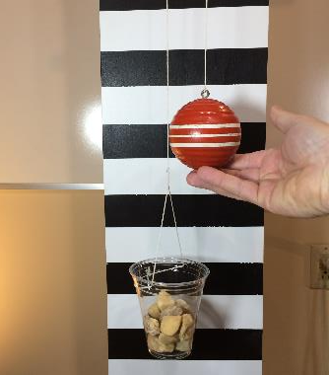
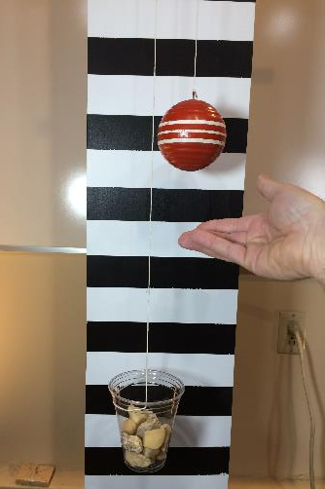
If an upward force is temporarily applied to the ball (via the magic hand), it will be accelerated because an net external force exists.
Upward Force
Once the “hand” force stops, the ball will continue to move at a constant rate because the forces are balanced and “acceleration” is zero.
This can be seen in the LabRat video.
Resultant Velocity

Slide 15
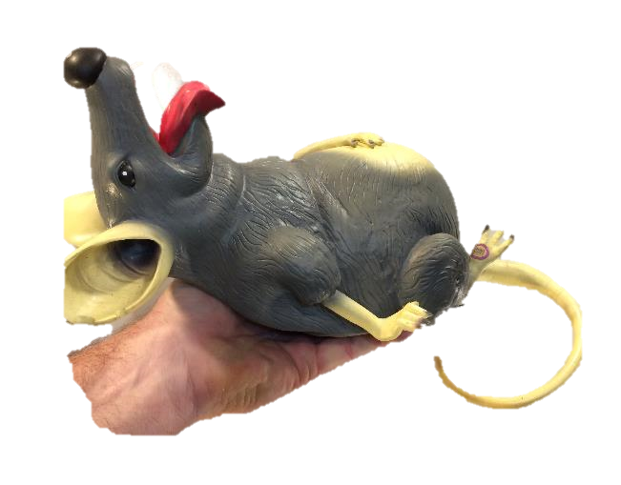
So, the force diagrams are identical. The only difference is the source of the equal and opposite upward force.

Slide 16
Let’s look at the “net” work being done on the rat. There are two forces and they are each performing work.
Work_{Upward} = Force_{Upward} * Displacement
If we move the rat upward, this work is defined as positive.
Work_{Downward} = Force_{Downward} * Displacement
Since the downward force acts opposite the displacement (movement) this work is defined as negative.

Slide 17
The rat has a weight of 4.9 N, and we lift it 1.0 m. We can calculate the positive and negative work being done on it…
Work_{Upward} = Force_{Upward} * Displacement
= 4.9 N * 1.0 m
= 4.9 N*m (this is a Positive work)
Work_{Downward} = Force_{Downward} * Displacement
= 4.9 N * 1.0 m
= 4.9 N*m (this is Negative work)
Net Work = 4.9 N*m + (- 4.9 N*m) = 0.0 N*m

Slide 18
This may be counterintuitive. We moved the rat, but there was no “net” work done on it…
However, if we look at the situation from the perspective of the magic hand, it did do some work and that was the force it applied over the distance the rat was moved.
Work_{Hand} = Force_{Hand} * Displacement
= 4.9 N * 1.0 m
= 4.9 N*m (this is a Positive work)

Slide 19
Notice that the magic hand applied 4.9 N*m of work and the change in Potential Energy was 4.9 N*m.
So, the work done (by the magic hand) is equal to the change in energy…

Slide 20
One last thought…
If we apply a force that is greater than the weight of the rat, the rat will accelerate upward. Since the forces acting on the rat are not constant in this case, there will be a “net” work done on it. The upward force is greater than the downward force, thus the positive work is greater than the negative work…
Ergo, Positive net work.

Slide 21
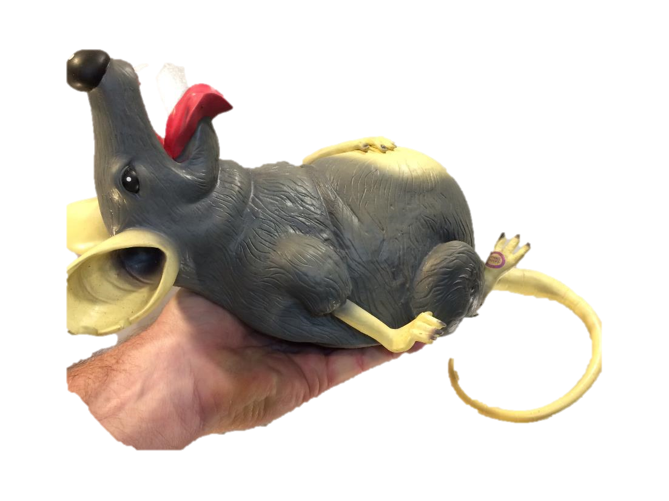
Questions?

